Slide 1
Assertional Knowledge Model
Yi Zhou

Slide 2
  Content
    Background
    From data model to knowledge model
    Assertional logic: syntax and semantics
    Assertional logic vs others
    Potential applications
    Conclusion

Slide 3
  Content
    Background
    From data model to knowledge model
    Assertional logic: syntax and semantics
    Assertional logic vs others
    Potential applications
    Conclusion

Slide 4

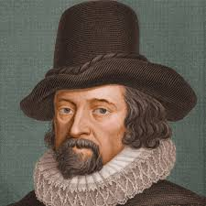
Knowledge is power

Slide 5

6E: What we need
Elegant
Extensible
Expressive
Efficient
Educable
Evolvable
representation
AI
reasoning
learning
    from data science to knowledge science
        knowledge representation
        knowledge reasoning
        knowledge learning

Slide 6
For Mathematics
    Mathematical logic depends on (naive) set theory,
    (axiomatic) set theory depends on logic
    Can’t define equality (can only define equivalence)
    Not very expressive (can’t represent general induction)
    Unnatural restrictions (quantification, free variable)
    A little too complicated and bizarre (as a foundation)
    Mathematicians don’t use logic to solve math problems

Slide 7
For Artificial Intelligence
    Too complicated (for engineers)
    Too much restrictions (for engineers)
    Not expressive enough
    Not extensible
    Undecidable, not efficient at all
    Principle of reasoning, but not how to reason
    No learning

Slide 8
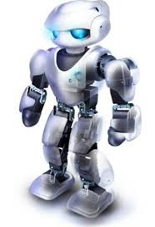

For Knowledge Representation
Plan
Relation
Time/Space
Algorithm
Preference
Action
Probability
Type
Proposition
Utility
Modality
Arithmetic
Fuzzy
Quantifier
Rule
Muliagents
Problem: one more building block, much more effort
Challenge: how to make them living happily ever after
Elegant
Extensible
Expressive

Slide 9
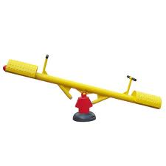
For Knowledge Reasoning
Expressiveness
Efficiency
Problem: more expressive less efficient, more efficient less expressive
Challenge: both are needed but there is no free lunch
Expressive
Efficient

Slide 10
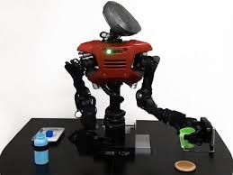
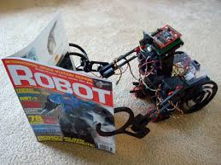
For Knowledge Learning
Problem: KR reasoners are algorithm based, little power to learn
Challenge: learnable reasoning
Educable
Evolvable

Slide 11
  Content
    Background
    From data model to knowledge model
    Assertional logic: syntax and semantics
    Assertional logic for knowledge modeling
    Assertional logic vs others
    Potential applications
    Conclusion

Slide 12

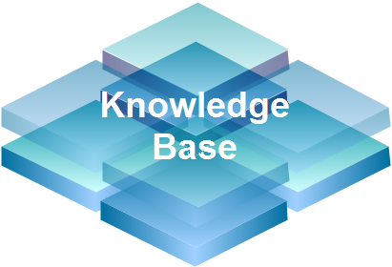
From Database to Knowledge Base

Slide 13
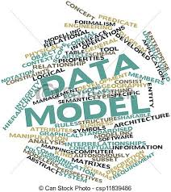

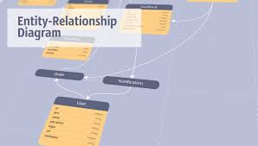
Data Modelling

Slide 14

Need for ……
Knowledge Model
Notes:
enterprise knowledge bases.
databases vs knowledge base
China mobile

Slide 15
Knowledge Model: Requirements
Elegant (to both human & machine)
Extensible (to both human & machine)
Expressive
Understandable (to both human & machine)
Query-able (from search to reasoning)
Acquisition-able (from manual to automatic)

Slide 16

KM I: Natural Language
Natural Languages
Elegant | Yes (relatively)
Extensible | Yes (relatively)
Expressive | Yes (relatively)
Understandable | No by machines
Query-able | Search, similarity
Acquisition-able | Yes but noisy, ambiguous, …

Slide 17
KM II: Data Model
Data models
Elegant | Yes
Extensible | No
Expressive | No
Understandable | Yes
Query-able | Yes
Acquisition-able | Mostly manual

Slide 18
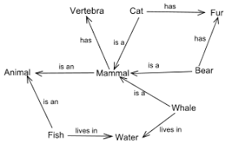
KM III: Semantic Network (KG)
Knowledge Graph
Elegant | Yes
Extensible | Yes
Expressive | No in practice
Understandable | Yes
Query-able | Search, path
Acquisition-able | (Semi) automatic

Slide 19
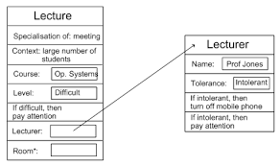
KM IV: Frame System
Frame System
Elegant | Middle
Extensible | Middle
Expressive | No
Understandable | Yes
Query-able | Search only
Acquisition-able | Mostly manual

Slide 20
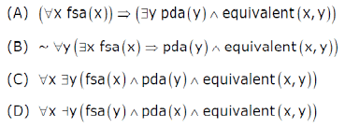
KM V: First-order Logic
First-order Logic
Elegant | No
Extensible | No
Expressive | Yes (relatively)
Understandable | Not really by human
Query-able | Yes but not efficient
Acquisition-able | Mostly manual

Slide 21
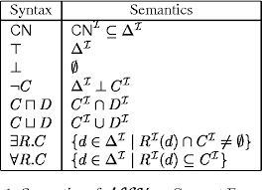
KM VI: Description Logic/OWL
Description Logic
Elegant | Middle
Extensible | No
Expressive | Yes (relatively)
Understandable | Middle by human
Query-able | Yes but not efficient enough
Acquisition-able | Mostly manual

Slide 22
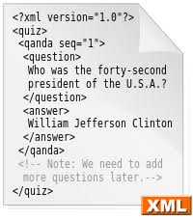
KM VII: XML
XML
Elegant | Yes (relatively)
Extensible | No
Expressive | No
Understandable | Yes (relatively)
Query-able | Yes but not deep enough
Acquisition-able | Mostly manual

Slide 23
  Content
    Background
    From data model to knowledge model
    Assertional logic: syntax and semantics
    Assertional logic vs others
    Potential applications
    Conclusion

Slide 24
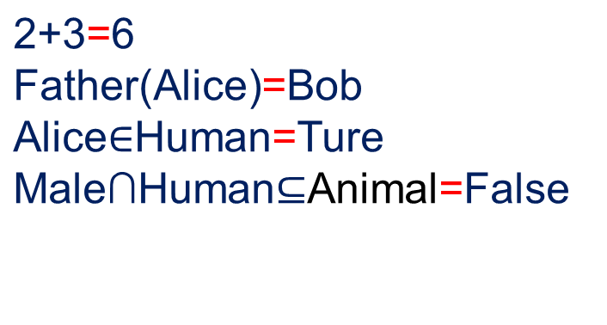
Assertional Logic
Syntax
Semantics
Individual
Concept
Operator
Element
Set
Function
Formalization
Knowledge
a=b
x or O(x1,…,xn)
I(a)=I(b)

Slide 25
Definition - Individual
i=a
1=Succ(0)

Slide 26
Definition - Operator
Op(C1,…,Cn)=T(C1,…,Cn)
Succ(n)={n,{n}}
Uncle(x)=Brother(Father(x))

Slide 27
Definition - Concept
Enumeration
C={i1,…,in}
Digit={1,2…,9}
Operation
C=C1∩C2
Man=Human∩Male
Comprehension
C’=C|A(C)
Male=Animal|Sex(Animal)=Male
Replacement
C’=Op(C)
Parent=ParentOf(Human)

Slide 28
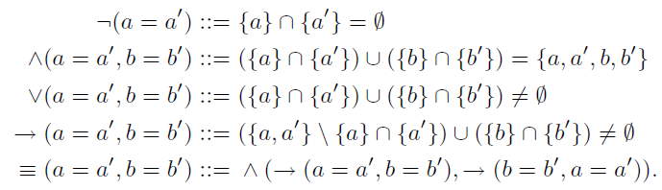
Propositional Connectives

Slide 29

Quantifiers

Slide 30


(Conditional) Probability

Slide 31
Time (Point)

Slide 32

KM 0: Assertional Logic
Assertional Logic
Elegant | Yes
Extensible | Yes
Expressive | Yes
Understandable | Yes
Query-able | Rule based reasoning
Acquisition-able | Learnable concepts & rules

Slide 33
  Content
    Background
    From data model to knowledge model
    Assertional logic: syntax and semantics
    Assertional logic vs others
    Potential applications
    Conclusion

Slide 34
AL vs Natural Language
    AL as a semantic representation language
    Semantic parsing to translate NL into AL
    For machine understandability and rule based reasoning
Natural Languages
Elegant | Yes (relatively)
Extensible | Yes (relatively)
Expressive | Yes (relatively)
Understandable | No by machines
Query-able | Search, similarity
Acquisition-able | Yes but noisy, ambiguous, …
Noun: Concept
Adjective: unary Boolean operator

Slide 35
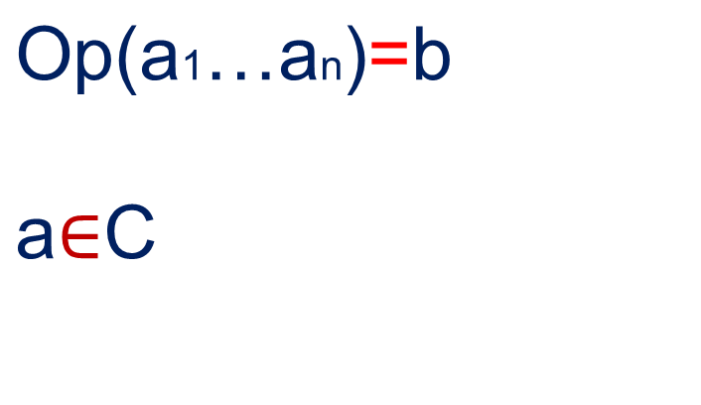
AL vs Data Models
    Entity → concept,
    relationship → binary Boolean operator,
    Attribute → unary operator
    Relation → binary operator
    AL for more extensibility and expressiveness
Data models
Elegant | Yes
Extensible | No
Expressive | No
Understandable | Yes
Query-able | Yes
Acquisition-able | Mostly manual

Slide 36
AL vs Semantic Network
    Node → concept,
    Edge → binary Boolean operator,
    AL for more extensibility, expressiveness and reasoning
    (Semi) automatic knowledge acquisition for AL
Knowledge Graph
Elegant | Yes
Extensible | No
Expressive | No in practice
Understandable | Yes
Query-able | Search, path
Acquisition-able | (Semi) automatic
    DB: level 0 knowledge
    SN: level 1 knowledge
    AL: level n knowledge

Slide 37
AL vs High-Order Logic
Elegant
Expressive
Extensible
C Concept of | HOL
Same individuals | FOL
Different individuals | Many sorted FOL
Concepts | Monadic SOL
Operators | SOL
Operators of … operators | HOL
Assertions | ???

Slide 38
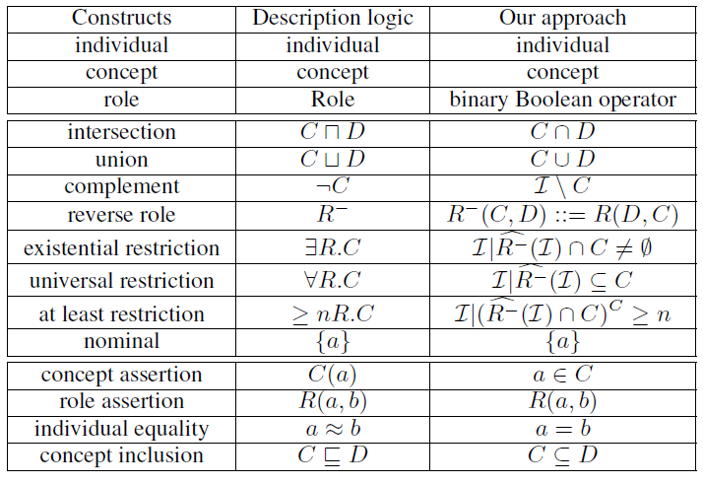
AL vs Description Logic I

Slide 39
AL vs Description Logic II
AL | Description Logic
n-ary operators | Binary relations
Comprehension/Replacement | Role Restriction
Complex assertions/quantifiers | Fragment of FOL
a=b | Different kinds
Extensibility by definition | Extensibility by new components

Slide 40
  Content
    Background
    From data model to knowledge model
    Assertional logic: syntax and semantics
    Assertional logic vs others
    Potential applications
    Conclusion

Slide 41
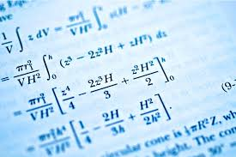
Mathematics test
Notes:
intelligence test.
IQ test
university entry level mathematics test

Slide 42
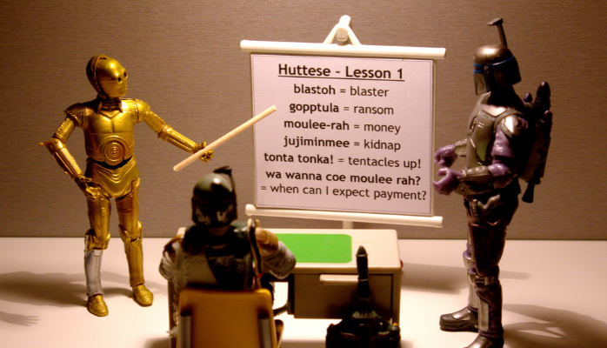
Natural language formalization
Notes:
Promising fields, all about knowledge
Machine learning + knowledge
collaboration

Slide 43
Enterprise knowledge base

Slide 44
  Content
    Background
    From data model to knowledge model
    Assertional logic: syntax and semantics
    Assertional logic vs others
    Potential applications
    Conclusion

Slide 45
Concluding Remarks
    From database/model to knowledge base/model
    Existing knowledge models and their problems
    Assertional logic as an knowledge model
    Assertional logic: syntax, semantic, extensibility
    Assertional logic vs other knowledge models
    Applications: the ultimate golden mine

Slide 46

Thank you!

